Slide 1
COMPUTER PROGRAMMING ASSIGNMENT II
BY
GROUP 2 MEMBERS

Slide 2
GROUP 2 MEMBERS
STUDENT NAME | PROGRAM | REG NUMBER
Chelimo Sandra | WAR | BU/UP/2024/5402
Nakazibwe Ethel | AMI | BU/UP/2024/0835
Poffia Adongo | AMI | BU/UP/2024/0823
Ogutu Daniel Wafula | WAR | BU/UP/2024/1060
Owor Hamidu | PTI | BU/UP/2024/2600
Muhangi Mouris Mathew | MEB | BU/UP/2024/5345
Odongo Joseph Aryong | AMI | BU/UP/2024/0840
Obur Charles | APE | BU/UP/2024/3743
Onanyang Francis | WAR | BU/UP/2024/4757
Econi Ronald | AMI | BU/UG/2024/5092

Slide 3
ABSTRACT
We began having a meeting for research on 26th September, 2025 in the university library and managed to achieve successful completion of this assignment through group work and division of tasks, and the achieved knowledge through the first assignment we did as a group as a tremendous means of consolidating the knowledge obtained to further the use of Matlab as a powerful tool for implementing algorithms , applying control structures and managing modular programming.

Slide 4
QUESTION
introduction
We are to explore the application of numerical methods and algorithm development techniques to solve real world engineering and scientific problems.

Slide 5
introduction
The assignment focuses on two major areas of computational mathematics
Numerical approximation methods for finding the solutions to nonlinear equations, such as Newton–Raphson, Bisection, and Secant methods.
Numerical methods for solving differential equations, such as Euler’s Method and Runge–Kutta Methods.

Slide 6
Part A
DEFINING THE FUNCTIONS AND DERIVATIVES
f=@(x) x.^5-2*x.^3+3*x-1;
df=@(x) 5*x.^4-6*x^2+3;
Explanation:
f = @(x): This command defines an anonymous function named f. The @ symbol indicates that it is a function handle. The variable x is the input to this function.
x.^5 - 2*x.^3 + 3*x - 1: This is the mathematical expression for the polynomial function. The. ^ operator is used for element-wise exponentiation, meaning it can handle arrays as input.
df = @(x): Similar to f, this defines the derivative of the function f.
5*x.^4 - 6*x.^2 + 3: This expression calculates the derivative of the polynomial, which will be used in methods like Newton-Raphson.

Slide 7
BISECTION METHOD
BISECTION METHOD
This is a numerical method used to find the root of an equation f(x) = 0. It is based on repeatedly having an interval where the function changes sign.
a=0; b=1;
tol=1e-6;
max1=50;
tic
for k=1:max1
c=(a+b)/2;
if f(c)==0 || (b-a)/2 <tol
break;
end
if f(a)*f(c)<0
b=c;
else
a=c;
end
end
root4bisection =c;
time4bisection =toc;

Slide 8
Initialization
a = 0; b = 1;
tol = 1e-6;
max1 = 50;
a = 0; b = 1; Initializes the endpoints of the interval \ ([a, b] \) where the function will be evaluated. The root is expected to lie within this interval.
tol = 1e-6; Sets the tolerance level for convergence. This value determines how close the approximation of the root must be to zero to consider the method successful.
max1 = 50; Specifies the maximum number of iterations the algorithm will perform. This prevents infinite loops in case the method does not converge.

Slide 9
Iterative Process
tic
for k = 1:max1
c = (a + b) / 2;
tic: Starts a timer to measure the execution time of the algorithm, which will be stopped by toc.
for k = 1:max1: Begins a for-loop that will iterate from 1 to max1. Each iteration represents one step in the bisection process.
c = (a + b) / 2; Calculates the midpoint of the interval \ ([a, b] \). This point c is where the function will be evaluated to check for a root.

Slide 10
Checking for Roots
if f(c) == 0 || (b - a) / 2 < tol
break;
end
if f(c) == 0: Checks if the function value at c is zero, which means c is a root.
(b - a) / 2 < tol: Checks if the width of the interval is smaller than the tolerance. If true, the method is considered to have converged, and the loop will break.
Updating the Interval
if f(a) * f(c) < 0
b = c;
else
a = c;
end
if f(a) * f(c) < 0: Determines if the root lies between a and c by checking if the product of f(a) and f(c) is negative. If it is, the root is in the interval \ ([a, c] \).
b = c; or a = c; Updates the interval based on where the root is believed to be.

Slide 11
NEWTON RAPHSON METHOD
Updating the Interval
if f(a) * f(c) < 0
b = c;
else
a = c;
end
if f(a) * f(c) < 0: Determines if the root lies between a and c by checking if the product of f(a) and f(c) is negative. If it is, the root is in the interval \ ([a, c] \).
b = c; or a = c; Updates the interval based on where the root is believed to be.
Storing Results
root4bisection = c;
time4bisection = toc;
root4bisection = c; Stores the approximate root found by the bisection method.
time4bisection = toc; Stops the timer and records the elapsed time since tic was called.

Slide 12
NEWTON RAPHSON METHOD
The Newton–Raphson method (also called the Newton method) is an iterative numerical technique used to find roots (solutions) of real-valued equations. In other words, it helps solve equations of the form f(x)=0 by successively improving an initial guess.
x0=0.5;
tic
for k=1:max1
x1=x0-f(x0)/df(x0);
if abs(x1-x0)<tol
break;
end
x0=x1;
end
root4newton=x1;
time4newton=toc;

Slide 13
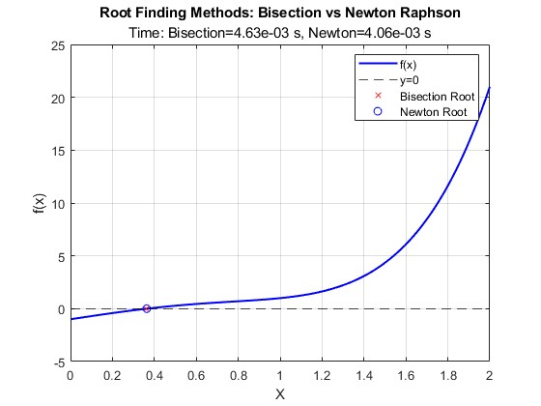
plot

Slide 14
PART B
INTRODUCTION
Here we looked at different methods of solving differential equations numerically. Which include Euler, Runge-Kutta and many others.
They have been explained below
PARAMETERS USED
T1 = 90;
Environmental Temperature
T_env = 25;
v=T_env;
Cooling rate
k = 0.5;
Interval
tspan = 0:1:60;
Differential Equation
f = @(T) -k*(T-v);

Slide 15
EULER METHOD
The Euler method is a numerical technique used to approximate the solution of ordinary differential equations (ODEs). It's a first-order method, meaning it uses the current estimate to calculate the next estimate.
T_euler = zeros(size(tspan));
T_euler(1) = T1;
tic
for i = 1:length(tspan)-1
T_euler(i+1) = T_euler(i) + f(T_euler(i))*(tspan(i+1)-tspan(i));
end
time4euler = toc;

Slide 16
Explanation:
T_euler = zeros(size(tspan)): Initializes an array T_euler to store the temperature values calculated using the Euler method. It is the same size as tspan.
T_euler(1) = T1: Sets the first element of T_euler to the initial temperature \( T1 \).
tic: Starts a timer to measure the execution time of the method.
for i = 1:length(tspan)-1: Loops through each time step, excluding the last one because it will calculate the next temperature.
T_euler(i+1) = T_euler(i) + f(T_euler(i)) * (tspan(i+1) - tspan(i)):
This line updates the temperature at the next time step based on the current temperature.
The term f(T_euler(i)) computes the rate of change at the current temperature.
The product f(T_euler(i)) * (tspan(i+1) - tspan(i)) gives the change in temperature over the interval, which is added to the current temperature.
time4euler = toc: Stops the timer and stores the execution time in time4euler.

Slide 17
RUNGE-KUTTA METHOD
T_rk4 = zeros(size(tspan));
T_rk4(1) = T1;
tic
for i = 1:length(tspan)-1
h = tspan(i+1)-tspan(i);
k1 = f(T_rk4(i));
k2 = f(T_rk4(i) + 0.5*h*k1);
k3 = f(T_rk4(i) + 0.5*h*k2);
k4 = f(T_rk4(i) + h*k3);
T_rk4(i+1) = T_rk4(i) + (h/6)*(k1 + 2*k2 + 2*k3 + k4);
end
time4rk4 = toc;
T_exact = v + (T1-v)*exp(-k*tspan);

Slide 18
Explanation:
T_rk4 = zeros(size(tspan)): Initializes an array T_rk4 to store the temperature values calculated using the RK4 method.
T_rk4(1) = T1: Sets the first element of T_rk4 to the initial temperature \( T1 \).
tic: Starts the timer.
for i = 1:length(tspan)-1: Loops through each time step.
h = tspan(i+1) - tspan(i): Calculates the time step size.
k1 = f(T_rk4(i)): Computes the first slope at the current temperature.
k2 = f(T_rk4(i) + 0.5*h*k1): Computes the slope at the midpoint using the first slope.

Slide 19
Explanation:
k3 = f(T_rk4(i) + 0.5*h*k2): Computes the slope at the midpoint again, but using the second slope.
k4 = f(T_rk4(i) + h*k3): Computes the slope at the end of the interval using the third slope.
T_rk4(i+1) = T_rk4(i) + (h/6)*(k1 + 2*k2 + 2*k3 + k4):
Updates the temperature for the next time step using a weighted average of the four slopes:
\( k1 \) contributes 1/6,
\( k2 \) contributes 2/6,
\( k3 \) contributes 2/6,
\( k4 \) contributes 1/6.
time4rk4 = toc: Stops the timer for the RK4 method.

Slide 20
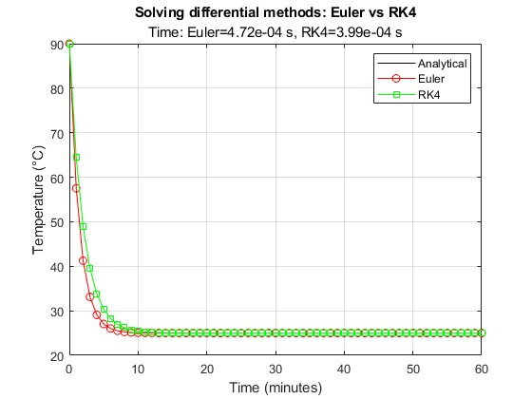
plot

Slide 21
HEUN’S METHOD
T_heun = zeros(size(tspan));
T_heun(1) = T1;
tic
for i = 1:length(tspan)-1
h = tspan(i+1)-tspan(i);
k1 = f(T_heun(i));
k2 = f(T_heun(i) + h*k1);
T_heun(i+1) = T_heun(i) + (h/2)*(k1 + k2);
end
time4heun = toc;

Slide 22
conclusion
We learned to use the Matlab program to compute several algorithms and how they are applied to real world problems hence being very useful in the real world systems.

